Slide 1
Title of the Thesis
Author: Student’s Name
Supervisor: Supervisor’s Name

Slide 2
Motivation for choice of topic, objective
Text
Text
Text
Text
Notes:
It is a good idea to start the presentation by briefly explaining why the student chose the topic. E.g. the topic was given because the student worked as an intern at company XY or the student had the idea to develop an application for problem XY or the student liked a topic from the department XY that was assigned by lecturer XY etc.
If the thesis is written in a corporate environment, it is not necessary to describe the company in detail, how many people work there, how many departments there are, etc. Only information about the company that is relevant to the implementation is given here. E.g. The software developed serves 5000 employees of a company with 11,000 employees, etc.
It is very important that the student clearly states in a concise summary here what the objective was at the start of the thesis (Objective) and that the student can present the "result" immediately, e.g. with a screenshot (A ). It is also possible to say that the needs changed along the way or that the planned application was successfully developed, etc.

Slide 3
Methods, tools used; Development environment, etc.
Text
Text
Text
Notes:
Be sure to mention what methods, tools, documentation solutions, e.g. UML modelling language, etc., the student used in the course of the work. E.g. if two people worked on a topic, it should also be explained how the work was shared, what software was used for teamwork, change tracking, etc. The development environments should then be described, either by listing them or by illustrating them with a diagram.

Slide 4
Title
Figures, pictures, tables, screenshots in the case of software development, code parts that the student finds important and that have been challenging to implement should be included rather than a lot of text to show their work.
Notes:
Afterwards, the implementation process should be described on 3-6 slides, highlighting the student's own work (e.g. if the work was done at a company where the student was part of a project team, the tasks the student completed should be clearly identified), and the results should be presented. Screenshots (if available) can be helpful.

Slide 5
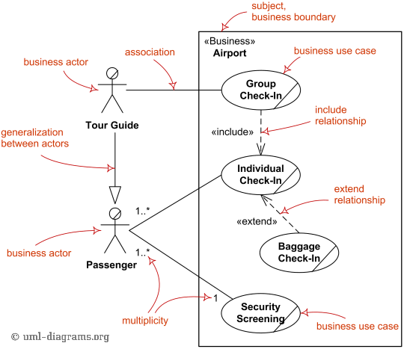
Title
Figures, pictures, tables, screenshots in the case of software development, code parts that the student finds important and that have been challenging to implement should be included rather than a lot of text to show their work.
Notes:
Afterwards, the implementation process should be described on 3-6 slides, highlighting the student's own work (e.g. if the work was done at a company where the student was part of a project team, the tasks the student completed should be clearly identified), and the results should be presented. Screenshots (if available) can be helpful.

Slide 6
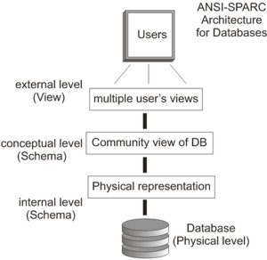
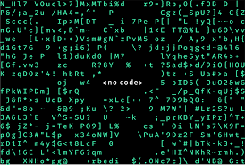
Title
Figures, pictures, tables, screenshots in the case of software development, code parts that the student finds important and that have been challenging to implement should be included rather than a lot of text to show their work.
Notes:
Afterwards, the implementation process should be described on 3-6 slides, highlighting the student's own work (e.g. if the work was done at a company where the student was part of a project team, the tasks the student completed should be clearly identified), and the results should be presented. Screenshots (if available) can be helpful.

Slide 7
Results, experiences
Results (The "product" produced should be presented here, e.g. if development was the aim of the thesis, the working software should be presented)
Text
Text
Experiences
Text
Text
Notes:
Summarise the work done and the results achieved, highlighting positive and negative experiences. This is where you can describe what knowledge you have gained from the work. Present the software!

Slide 8
Directions for further development
Notes:
It is definitely worth talking briefly for 1 slide about how to take the work forward. What are the student's ideas for the development or operation of the finished product. If someone has done software development work that has resulted in software used by a user community, there should definitely be a discussion about implementation and operational issues, there should be a vision for this as well.

Slide 9
Thank you for your attention!

Slide 10
Questions asked by the Referee
(If there are questions, go ahead. Let's ask the Committee if they would like to answer the questions posed by the reviewer.)
Question 1.
Question 2.
Question 3.

